Slide 1
Optimizing Short Volatility Strategies
Enhancing Returns with Covered Calls and Protective Puts

Slide 2
Executive Summary
Rates ETF option selling captures volatility and generates consistent returns over pure ETF allocation
The US Treasury Bond UCITS ETF (20+ years maturity) has high duration but limited upside due to low yields.
High volatility presents an opportunity to systematically harvest risk premia
Selling upside is advantageous as the yield of the bonds in the index can be lower than financing costs.
Short volatility strategies can be tailored along various dimensions.
Daily vs. Monthly Selling: Daily selling offers more stable alpha and Sharpe ratio with more regular cash flows
Strike Options: OTM for higher potential gains but very volatile or ATM for more stable alpha
Target Yield Strategies: High target yield works well in low-volatility environments but very risky in adverse markets
Stop-Loss Impact: Improves returns significantly across all scenarios, with no single best level for all market conditions
Strike Selection vs. Variable Weight: Variable weight is superior in volatile markets
Calls vs. Calls & Puts: Calls & Puts delivers higher alpha
Gap Strike for Calls & Puts: OTM outperforms in volatile markets whereas ATM provides more stable alpha

Slide 3
Agenda
1 | Scope and Data
2 | Analysis and Results
3 | Appendix

Slide 4
Scope and Data
1

Slide 5
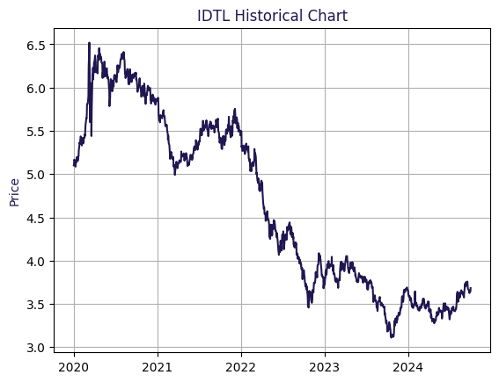
Overview Of The Underlying Asset And Data Scope
Key Characteristics of the Index
Tracks U.S. Treasury bonds with maturities of +20 years
Offers a semi-annual distribution, providing regular income
Shows high sensitivity to rate changes due to long duration
Scope of Study
Our analysis focuses on the iShares USD Treasury Bond +20yr (ODTL) ETF, utilizing data since 2021
We rely on daily option prices for all strikes and maturities from our internal database
Why shorting IDTL ?
Shorting IDTL is "cheap" as financing cost are higher than the yield to underlying
High duration leads to significant volatility, allowing us to sell options at higher prices. By consistently harvesting this volatility, we enhance portfolio returns with some extra risk

Slide 6
Analysis and Results
2

Slide 7
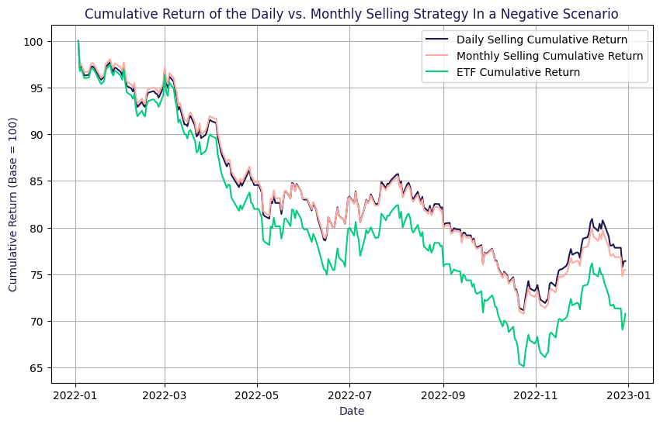
Daily Option Selling Performs Better In Negative Scenario
Which Selling Frequency is the Best One ?
Hedging Dynamics
Monthly Selling
Full hedging established at the beginning of the month
Daily Selling
Gradual hedge development throughout the month
Potentially weaker hedge early in the month
Cash Flow Characteristics
Monthly Selling
Irregular cash flows aligned with a single transaction
Daily Selling
More consistent and compounding cash flows
Ability to remain closer to the ATM strike during selling
ATM strike selection, 5% target yield, no stop loss, calls only

Slide 8
Daily Selling Provides More Consistent Cash-Flow And More Stable Alpha
Key Observation
Scenario (Positive Negative Neutral) | Index | Daily Selling | Monthly Selling
Annualised Alpha |  | 2,76% 0,79% 0,66% | 3,94% -0,73% 0,65%
Beta vs. Underlying |  | 0,817 0,835 0,877 | 0,798 0,814 0,871
Annualised Return | 11,56% -28,75% 1,13% | 12,12% -23,20% 2,05% | 13,07% -24,14% 2,05%
Annualised Volatility | 12,31% 18,03% 14,60% | 10,23% 15,33% 13,12% | 10,00% 14,94% 13,05%
Annualised Sharpe Ratio | 0,978 -1,599 -0,143 | 1,232 -1,518 -0,089 | 1,355 -1,621 -0,089
Max Drawdown | -6,08% -33,20% -20,06% | -5,37% -27,22% -16,72% | -5,28% -27,86% -16,82%
Alpha & Risk-Return Profile
Daily selling ensures more stable alpha, reducing the risk of negative performance
Monthly selling can achieve higher alpha, but at the cost of greater downside risk
Returns & Sharpe Ratio Across Scenarios
Daily selling outperforms in negative scenarios
Monthly selling excels in positive markets
Volatility & Strategy Considerations
Both strategies surpass ETF performance, improving risk-return efficiency
Daily selling provides more consistent cash flow, while monthly selling offers a stronger initial hedge

Slide 9
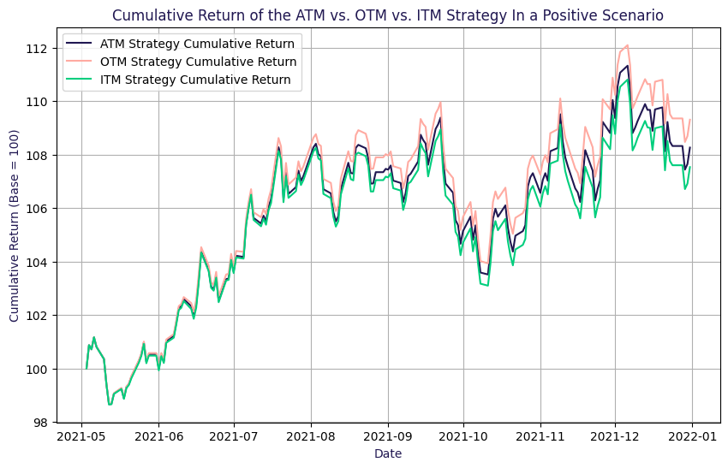
Researchers Are Right OTM Strategies Deliver Stronger Risk-Adjusted Returns In Volatile Market
Researchers Shorted OTM Options. Best Strategy?
In-the-Money Calls
Higher premiums generated upon selling
Increased risk of exercise at expiry, leading to potential losses
Creates a larger buffer to offset adverse market movements
Out-of-the-Money Calls
Lower premiums, but safer positioning
Reduced probability of being exercised
Mitigates downside risk, particularly in volatile markets
At-the-Money Calls (Baseline)
Balanced approach with moderate premiums and risk
Serves as a control for comparison
Daily selling, strike selection, 5% target yield, no stop loss, calls only

Slide 10
Maximizing Returns With OTM Strategies; Higher But Unstable Alpha
Key Observation
Scenario (Positive Negative Neutral) | -2% ATM (ITM) | ATM | +2% ATM (OTM)
Annualised Alpha | 1,49% 0,41% 1,19% | 2,76% 0,79% 0,66% | 4,38% 1,37% -0,65%
Beta vs. Underlying | 0,832 0,836 0,893 | 0,817 0,835 0,877 | 0,812 0,837 0,857
Annualised Return | 11,03% -23,63% 2,54% | 12,12% -23,20% 2,05% | 13,68% -22,67% 0,78%
Annualised Volatility | 10,40% 15,30% 13,38% | 10,23% 15,33% 13,12% | 10,19% 15,60% 12,85%
Annualised Sharpe Ratio | 1,106 -1,549 -0,050 | 1,232 -1,518 -0,089 | 1,390 -1,459 -0,190
Max Drawdown | -5,36% -27,54% -17,06% | -5,37% -27,22% -16,72% | -5,49% -26,98% -16,60%
Alpha and Risk Trade-Offs
OTM options capture highly volatile alpha, with strong gains in positive markets and heavy losses in downturns.
ATM options offer a more stable approach, consistently delivering positive alpha across various market conditions
Performance and Volatility Considerations
ITM options perform best in neutral/low-volatility markets, providing stable returns
OTM options are ideal for high-volatility environments, offering higher potential returns but greater risk exposure
Choosing the Right Strategy
The best approach depends on market conditions, as each option type has distinct strengths and weaknesses

Slide 11
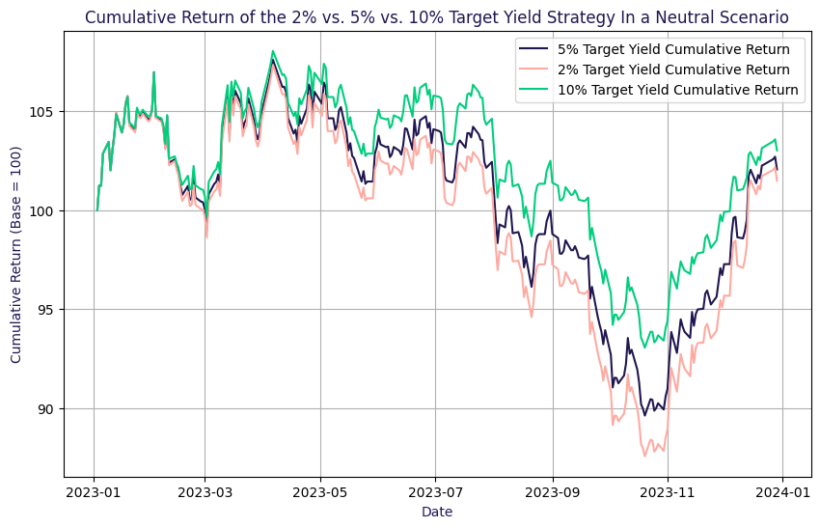
Target Yield Strategies Superior Performance With Higher Yields In Low Volatile Markets
Lower Exposure or Larger Cushion ?
Adjusting the target yield influences both the risk and returns of the strategy
Targeting an additional 5% yield through option selling
Lower Target Yield (<5%)
Lower risk exposure.
Lower premiums collected
Higher Target Yield (>5%)
Higher premiums cushion downside risk
Increased risk of adverse market impacts
Determine the relationship between target yield and
Risk-adjusted returns
Long-term sustainability of the strategy
Daily selling, ATM strike selection, no stop loss, calls only

Slide 12
High Target Yields Larger Cash Cushion But Too Risky In Extreme Volatility
Key Observation
Scenario (Positive Negative Neutral) | 2% | 5% | 10%
Annualised Alpha | 1,35% -0,35% 0,19% | 2,76% 0,79% 0,66% | 5,10% 2,78% 1,44%
Beta vs. Underlying | 0,858 0,870 0,926 | 0,817 0,835 0,877 | 0,749 0,779 0,798
Annualised Return | 11,20% -25,36% 1,48% | 12,12% -23,20% 2,05% | 13,64% -19,60% 3,00%
Annualised Volatility | 10,72% 15,87% 13,86% | 10,23% 15,33% 13,12% | 9,45% 14,65% 12,05%
Annualised Sharpe Ratio | 1,090 -1,603 -0,125 | 1,232 -1,518 -0,089 | 1,495 -1,343 -0,018
Max Drawdown | -5,52% -29,43% -18,44% | -5,37% -27,22% -16,72% | -5,12% -23,55% -13,89%
High Target Yields and Market Conditions
High target yield strategies perform well across different approaches but struggle in extreme volatility
During recent high-volatility periods (End 2023), lower target yields outperformed, proving more resilient
Cash Cushioning and Risk Control
Higher target yields build a stronger cash cushion but is very risky in adverse market, this risk can be mitigated by using stop-loss to minimize the impact on the portfolio
Performance in Low Volatility Environments
High target yields excel in low-volatility markets, as seen in recent years
Every key metric (returns, risk-adjusted performance) favors high target yields when volatility is low

Slide 13
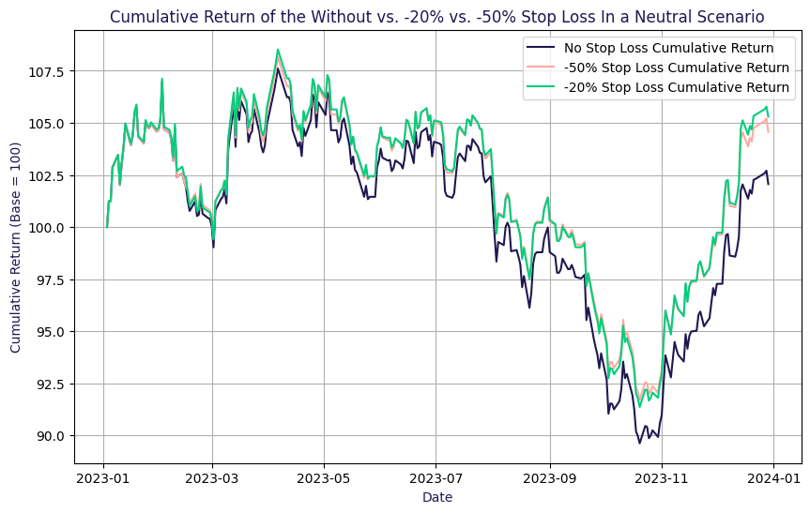
Stop Loss A Must-Have, Improving Alpha And Returns
Are Stop Loss Efficient ?
Key Mechanism
Introducing a stop loss to manage downside risk by cutting losses on sold options
Daily monitoring of option prices
Triggered when the ratio of market price to book price falls below a specified threshold
Risk Management
Prevent excessive losses by buying back options when the threshold is breached
Protect the portfolio against adverse market moves
Threshold Variations
Testing different stop loss levels to evaluate
Conservative settings (tight thresholds)
Aggressive settings (wider thresholds)
Daily selling, ATM strike selection ,5% target yield, calls only

Slide 14
The Optimized Threshold For The Stop Loss Varies Across Different Scenarios
Key Observation
Scenario (Positive Negative Neutral) | Without Stop Loss | Stop Loss of 20% | Stop Loss of 50%
Annualised Alpha | 2,76% 0,79% 0,66% | 5,34% 2,51% 3,88% | 5,17% 3,02% 3,11%
Beta vs. Underlying | 0,817 0,835 0,877 | 0,820 0,819 0,880 | 0,806 0,808 0,863
Annualised Return | 12,12% -23,20% 2,05% | 14,74% -21,02% 5,26% | 14,40% -20,21% 4,53%
Annualised Volatility | 10,23% 15,33% 13,12% | 10,27% 14,97% 13,16% | 10,10% 14,84% 12,93%
Annualised Sharpe Ratio | 1,232 -1,518 -0,089 | 1,481 -1,410 0,155 | 1,473 -1,368 0,102
Max Drawdown | -5,37% -27,22% -16,72% | -5,16% -25,48% -15,81% | -5,05% -24,61% -15,21%
Impact of Stop-Loss
Stop-Loss significantly enhances returns and alpha by cutting losing trades before they deepen
Stop-Loss implementation is beneficial in all market scenarios
Effectiveness Across Market Conditions
Closing losing positions early prevents deeper losses
It has a moderate impact on max drawdown but does not notably reduce volatility
No Universal Optimal Level
No single stop-loss level is best, its effectiveness depends on the underlying asset’s price path

Slide 15
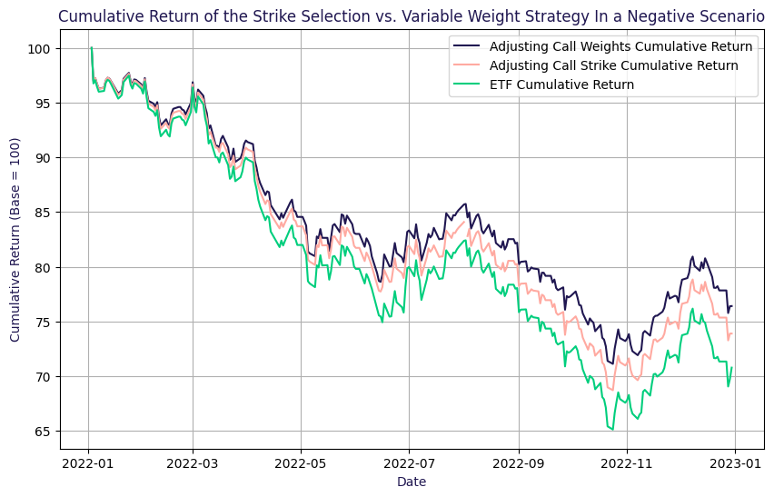
Target Yield vs. Exposure Focus Variable Weight Strategy Delivers Higher Returns And Alpha
Strike or Weight Adjustments ?
Hedging Dynamics
Variable Strike
Adjust strike price to meet the target yield
Higher premiums for ITM options, lower premiums for OTM options
Variable Weight
Keep a fixed ATM strike and adjust option quantity to reach the target yield
Strategic Comparison
Variable Strike
Directly impacts premiums and exercise probability
Variable Weight
Keeps strike risk constant but adjusts exposure, affecting diversification and leverage
Daily selling, 5% target yield, no stop loss, calls only

Slide 16
Variable Weight Strategy Higher Returns With Comparable Volatility
Key Observation
Scenario (Positive Negative Neutral) | Index | Strike Selection | Variable Weight
Annualised Alpha |  | 0,33% -0,78% 0,71% | 2,76% 0,79% 0,66%
Beta vs. Underlying |  | 0,866 0,866 0,930 | 0,817 0,835 0,877
Annualised Return | 11,56% -28,75% 1,13% | 10,28% -25,76% 1,99% | 12,12% -23,20% 2,05%
Annualised Volatility | 12,31% 18,03% 14,60% | 10,81% 15,81% 13,96% | 10,23% 15,33% 13,12%
Annualised Sharpe Ratio | 0,978 -1,599 -0,143 | 0,995 -1,634 -0,088 | 1,232 -1,518 -0,089
Max Drawdown | -6,08% -33,20% -20,06% | -5,49% -29,63% -18,51% | -5,37% -27,22% -16,72%
Performance in Volatile Markets
Variable weight strategy outperforms in volatile markets with higher alpha and Sharpe ratio
In neutral markets, both strategies perform similarly, making volatility a key determinant of success
Limitations of Strike Selection
Strike selection can underperform, even compared to the ETF itself, highlighting its inefficiency
Preferred Approach
Fixing the strike and adjusting quantity is superior to fixing quantity and adjusting strikes
This method ensures more stable performance

Slide 17
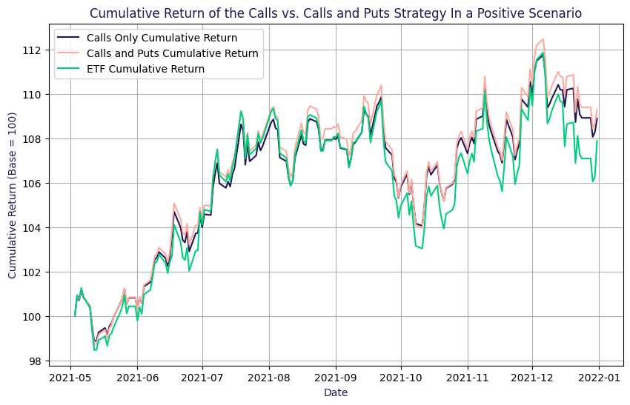
Maximizing Alpha The Power Of Combining Calls & Puts
Are Researchers Right about Selling Calls & Puts ?
Research Insights
Previous studies suggest
Lower portfolio volatility with calls and puts
Improved Sharpe ratio due to balanced risk exposure
Better performance in sideways or volatile markets
Calls and Put strike are symmetric between the ATM strike
Researchers Quotes
"Adjusting call/put strikes balances yields and enhances consistency.“ "Covered OTM calls and puts offer higher income than covered calls alone.“ "A combined strategy provides better downside protection.“
Monthly selling, ATM strike selection, 5% target yield, no stop loss

Slide 18
Calls & Puts Outperforming, Especially In Negative Scenarios
Key Observation
Scenario (Positive Negative Neutral) | Index | Calls | Calls and Puts
Annualised Alpha |  | 3,94% -0,73% 0,65% | 3,79% -0,20% 0,93%
Beta vs. Underlying |  | 0,798 0,814 0,871 | 0,860 0,897 0,927
Annualised Return | 11,56% -28,75% 1,13% | 13,07% -24,14% 2,05% | 13,66% -25,99% 2,21%
Annualised Volatility | 12,31% 18,03% 14,60% | 10,00% 14,94% 13,05% | 10,78% 16,42% 13,87%
Annualised Sharpe Ratio | 0,978 -1,599 -0,143 | 1,355 -1,621 -0,089 | 1,312 -1,588 -0,072
Max Drawdown | -6,08% -33,20% -20,06% | -5,28% -27,86% -16,82% | -5,83% -30,22% -18,14%
Higher Volatility but Better Alpha
Calls & Puts strategy is more volatile, leading to a higher max drawdown than selling calls only
Alpha is stronger in Calls & Puts, making it the preferred choice in most scenarios
Risk and Return Profile
Sharpe ratio remains similar between both strategies despite the higher volatility in Calls & Puts
Higher beta in Calls & Puts makes it more sensitive to market movements, aligning closely with the index
Scenario-Based Performance
Calls & Puts outperform in all scenarios except the positive one, where calls alone perform better

Slide 19
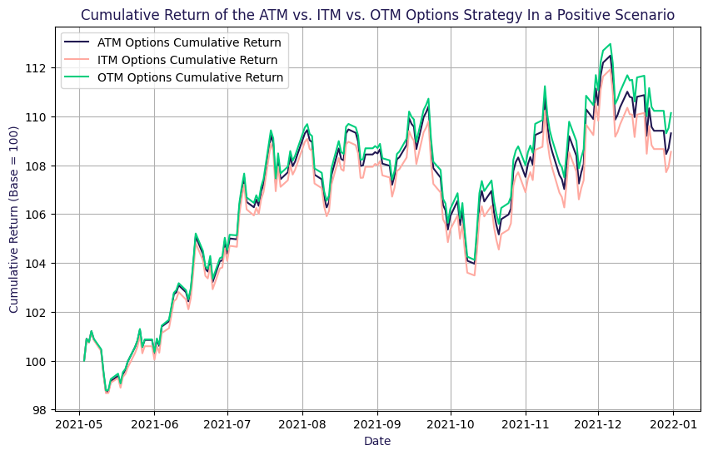
OTM Provides Leverage, ATM Captures Growth In Calm Markets
ATM / ITM or OTM when Selling Calls & Puts ?
Exploring Strike Influence
Investigating how strike selection affects performance
Maintaining Exposure
To keep consistent exposure, strikes must remain symmetric around ATM
This ensures delta compensation between calls & puts
Comparing Different Strikes
Evaluating ATM, ITM, and OTM options
Assessing their impact on returns, risk, and portfolio stability
Monthly selling, Calls and Puts, 5% target yield, no stop loss

Slide 20
Optimizing Strike Selection OTM Excels In Volatile Markets, ATM Gives More Stable Alpha
Key Observation
Scenario (Positive Negative Neutral) | Calls and Puts (-2% ITM) | Calls and Puts (ATM) | Calls and Puts (+2% OTM)
Annualised Alpha | 2,50% -0,45% 0,80% | 3,79% -0,20% 0,93% | 5,05% 0,18% -1,44%
Beta vs. Underlying | 0,873 0,894 0,934 | 0,860 0,897 0,927 | 0,859 0,896 0,889
Annualised Return | 12,53% -26,16% 2,06% | 13,66% -25,99% 2,21% | 14,91% -25,57% -0,08%
Annualised Volatility | 10,92% 16,33% 13,99% | 10,78% 16,42% 13,87% | 10,78% 16,45% 13,39%
Annualised Sharpe Ratio | 1,192 -1,607 -0,082 | 1,312 -1,588 -0,072 | 1,428 -1,559 -0,246
Max Drawdown | -5,75% -30,36% -18,48% | -5,83% -30,22% -18,14% | -5,96% -29,57% -17,80%
Risk vs. Reward Trade-Off
OTM options are the riskiest, showing highly volatile alpha and Sharpe ratios across scenarios
ATM options provide the most stable alpha, ensuring consistent positive performance with lower variability
Sensitivity
Beta is slightly higher for ITM options, indicating greater sensitivity to market moves
Drawdown and Risk Appetite
OTM options have the lowest max drawdown, offering better downside protection
Choosing the best strategy depends on risk appetite, balancing return potential vs. stability

Slide 21
Thank you!
Leon Von Essen FIC ETD Research & Development
Eurex London Branch
11 Westferry Circus
E14 4HE, London, UK
Tel: +44 7484 063479
leon.von.essen@eurex.com
Joudy Benkaddour FIC ETD Research & Development
Eurex Frankfurt AG
Mergenthalerallee 61
65760 Eschborn
joudy.benkaddour@eurex.com

Slide 22
Disclaimer
© Eurex 2020
Deutsche Börse AG (DBAG), Clearstream Banking AG (Clearstream), Eurex Frankfurt AG, Eurex Clearing AG (Eurex Clearing) and Eurex Repo GmbH (Eurex Repo) are corporate entities and are registered under German law. Eurex Global Derivatives AG is a corporate entity and is registered under Swiss law. Clearstream Banking S.A. is a corporate entity and is registered under Luxembourg law. Deutsche Boerse Asia Holding Pte. Ltd., Eurex Clearing Asia Pte. Ltd. and Eurex Exchange Asia Pte. Ltd are corporate entities and are registered under Singapore law. Eurex Frankfurt AG (Eurex) is the administrating and operating institution of Eurex Deutschland. Eurex Deutschland is in the following referred to as the “Eurex Exchange”.
All intellectual property, proprietary and other rights and interests in this publication and the subject matter hereof (other than certain trademarks and service marks listed below) are owned by DBAG and its affiliates and subsidiaries including, without limitation, all patent, registered design, copyright, trademark and service mark rights. While reasonable care has been taken in the preparation of this publication to provide details that are accurate and not misleading at the time of publication DBAG, Clearstream, Eurex, Eurex Clearing, Eurex Repo as well as the Eurex Exchange and their respective servants and agents (a) do not make any representations or warranties regarding the information contained herein, whether express or implied, including without limitation any implied warranty of merchantability or fitness for a particular purpose or any warranty with respect to the accuracy, correctness, quality, completeness or timeliness of such information, and (b) shall not be responsible or liable for any third party’s use of any information contained herein under any circumstances, including, without limitation, in connection with actual trading or otherwise or for any errors or omissions contained in this publication.
This publication is published for information purposes only and shall not constitute investment advice respectively does not constitute an offer, solicitation or recommendation to acquire or dispose of any investment or to engage in any other transaction. This publication is not intended for solicitation purposes but only for use as general information. All descriptions, examples and calculations contained in this publication are for illustrative purposes only.
Eurex and Eurex Clearing offer services directly to members of the Eurex Exchange respectively to clearing members of Eurex Clearing. Those who desire to trade any products available on the Eurex market or who desire to offer and sell any such products to others or who desire to possess a clearing license of Eurex Clearing in order to participate in the clearing process provided by Eurex Clearing, should consider legal and regulatory requirements of those jurisdictions relevant to them, as well as the risks associated with such products, before doing so.
Only Eurex derivatives that are CFTC-approved may be traded via direct access in the United States or by United States persons. A complete, up-to-date list of Eurex derivatives that are CFTC-approved is available at http//www.eurexchange.com/exchange-en/products/eurex-derivatives-us. In addition, Eurex representatives and participants may familiarise U.S. Qualified Institutional Buyers (QIBs) and broker-dealers with certain eligible Eurex
equity options and equity index options pursuant to the terms of the SEC’s July 1, 2013 Class No-Action Relief. A complete, up-to-date list of Eurex options that are eligible under the SEC Class No-Action Relief is available at http//www.eurexchange.com/exchange-en/products/eurex-derivatives-us/eurex-options-in-the-us-for-eligible-customers... Lastly, U.S. QIBs and broker-dealers trading on behalf of QIBs may trade certain single-security futures and narrow-based security index futures subject to terms and conditions of the SEC’s Exchange Act Release No. 60,194 (June 30, 2009), 74 Fed. Reg. 32,200 (July 7, 2009) and the CFTC’s Division of Clearing and Intermediary Oversight Advisory Concerning the Offer and Sale of Foreign Security Futures Products to Customers Located in the United States (June 8, 2010).
Trademarks and Service Marks
Buxl®, DAX®, DivDAX®, eb.rexx®, Eurex®, Eurex Repo®, Eurex Strategy WizardSM, Euro GC Pooling®, FDAX®, FWB®, GC Pooling®,,GCPI®, MDAX®, ODAX®, SDAX®, TecDAX®, USD GC Pooling®, VDAX®, VDAX-NEW® and Xetra® are registered trademarks of DBAG. All MSCI indexes are service marks and the exclusive property of MSCI Barra. ATX®, ATX® five, CECE® and RDX® are registered trademarks of Vienna Stock Exchange AG. IPD® UK Quarterly Indexes are registered trademarks of Investment Property Databank Ltd. IPD and have been licensed for the use by Eurex for derivatives. SLI®, SMI® and SMIM® are registered trademarks of SIX Swiss Exchange AG. The STOXX® indexes, the data included therein and the trademarks used in the index names are the intellectual property of STOXX Limited and/or its licensors Eurex derivatives based on the STOXX® indexes are in no way sponsored, endorsed, sold or promoted by STOXX and its licensors and neither STOXX nor its licensors shall have any liability with respect thereto. Bloomberg Commodity IndexSM and any related sub-indexes are service marks of Bloomberg L.P. PCS® and Property Claim Services® are registered trademarks of ISO Services, Inc. Korea Exchange, KRX, KOSPI and KOSPI 200 are registered trademarks of Korea Exchange Inc. BSE and SENSEX are trademarks/service marks of Bombay Stock Exchange (BSE) and all rights accruing from the same, statutory or otherwise, wholly vest with BSE. Any violation of the above would constitute an offence under the laws of India and international treaties governing the same. The names of other companies and third party products may be trademarks or service marks of their respective owners.
Eurex Deutschland qualifies as manufacturer of packaged retail and insurance-based investment products (PRIIPs) under Regulation (EU) No 1286/2014 on key information documents for packaged retail and insurance-based investment products (PRIIPs Regulation), and provides key information documents (KIDs) covering PRIIPs traded on Eurex Deutschland on its website under the following link http//www.eurexchange.com/exchange-en/resources/regulations/eu-regulations/priips-kids.
In addition, according to Art. 14(1) PRIIPs Regulation the person advising on, or selling, a PRIIP shall provide the KID to retail investors free of charge.

Slide 23
Appendix

Slide 24
Optimizing Cash Flow With Adaptive Option Selling Strategies
Key Goals and Core Concept
Focus on 1-month expiry options
Avoid selling options with less than 5 days to expiry due to high volatility
Instead, sell options with the next available expiry date to minimize gamma risks
Portfolio Allocation
90% invested in the underlying
Maintain a 10% cash buffer to quickly repurchase the underlying if needed, ensuring consistent exposure
Manage exposure and delivery
No buybacks are performed after selling, except for managing exercised options
At every delivery date, if an option is exercised, we deliver the underlying from our portfolio and then buy it back to maintain exposure
Goals of the presentation
Present and compare various short volatility strategies to identify the most effective one through back-testing
Generate consistent cash flows by selling calls and puts, while maintaining exposure to the underlying asset
Research inspired by the paper “Applications of Stock Index Options for Income Enhancement” by John Burrello, Frank J. Fabozzi, Han Liang, Anil Sood, and Kari Vatanen
Important point of the research paper
High volatility leads to higher option premiums and yields
Selling options with the same strike prices without adapting to market conditions is a common pitfall

Slide 25
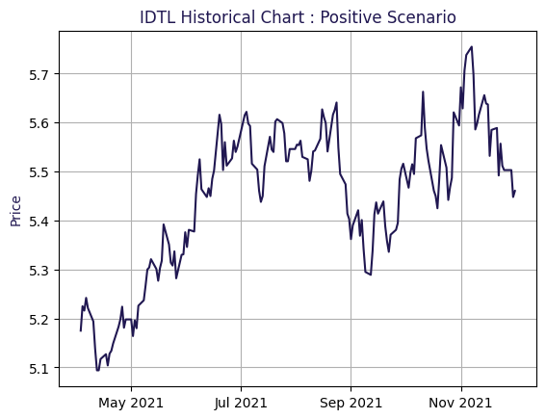
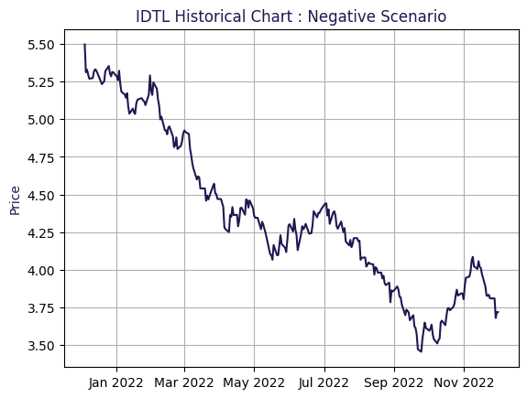
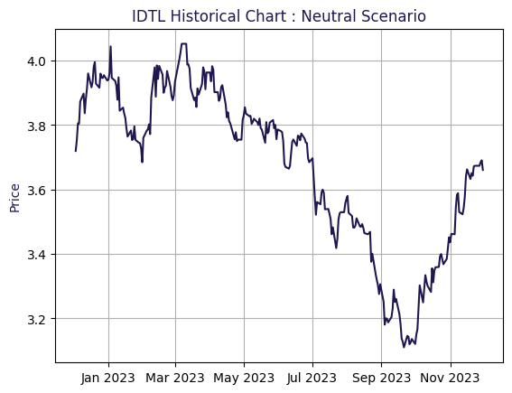
Testing The Strategy In Three Market Scenarios
Scenario Choice
Approach
To evaluate our strategy, we analyze three market scenarios
Positive Scenario Index price increases
Negative Scenario Index price decreases
Neutral Scenario Market remains stable
Data Periods
Positive Scenario May 2021 to December 2021
Negative Scenario January 2022 to December 2022
Neutral Scenario January 2023 to December 2023
Assumptions
No transaction costs
No impact on market prices due to trades

